Slide 1

Bank Loan Analytics Dashboard
A comprehensive overview of the bank's loan portfolio, providing key insights into its performance and areas for strategic improvement.
Presented By-
Chetana
Datta
Rohini
Shubham
Sandhiya
Seeena

Slide 2
Agenda
Problem Statement: Challenges and Risks
Dashboard Overview: Key Metrics
Portfolio Growth & Diversification
Sectoral Concentration & Emerging Opportunities
Loan Categories & Risk Assessment
Overall Portfolio Health
Key Takeaways

Slide 3
Problem Statement: Challenges & Risks
Lack of Diversification
Limited Product Offerings
Missed Opportunities
Loan portfolio heavily concentrated in the commercial sector (51%), increasing risk exposure.
Not actively pursuing high-growth industries like renewable energy and healthcare.
Primarily traditional loans, limiting attraction of new customers and market share growth.
These challenges could lead to reduced profitability, increased risk exposure, and missed market opportunities, impacting long-term financial sustainability.

Slide 4
Dashboard Overview: Key Metrics
The bank loan analytics dashboard provides a comprehensive overview of the bank's loan portfolio, offering insights into:
$511.11M
51%
2.15%
Total Funded Amount
Commercial Loans
Low Delinquency Rate
Increased from $256.24M in 2007 to $511.11M in 2023.
Majority of loans are for commercial purposes.
Indicates strong repayment performance.
The dashboard also tracks total amount received, revolving balance, and total accounts.

Slide 5
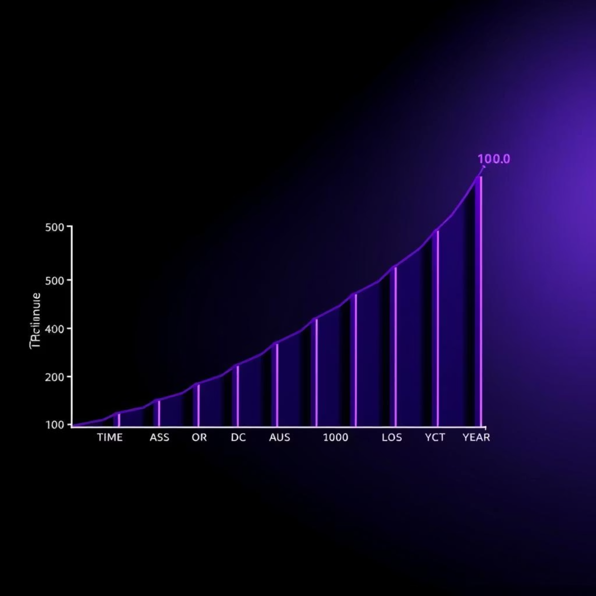
Portfolio Growth & Diversification
The bank's loan portfolio shows steady growth, with the total funded amount significantly increasing from 2007 to 2023.
While commercial loans still dominate, the portfolio is becoming more diversified across various industries.

Slide 6


Sectoral Concentration & Emerging Opportunities
Technology Sector Growth
Small Business Focus
Technology loans increased from 18% in 2007 to 37% in 2023.
Small business loans grew from 25% in 2007 to 33% in 2023.
These shifts highlight evolving focus areas and potential for further expansion into high-growth sectors.

Slide 7
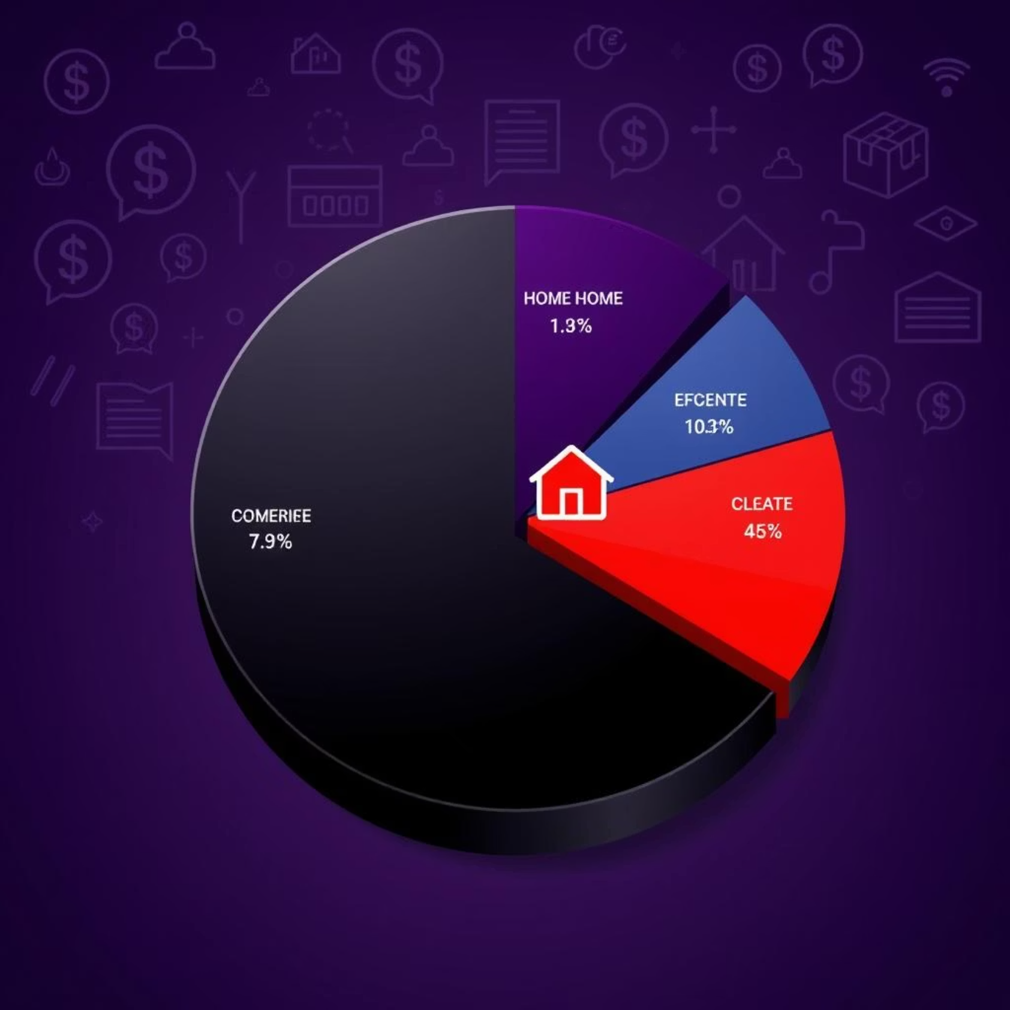
Loan Categories & Risk Assessment
Top Loan Categories
Home Ownership: 82.64%
Term Loans: 17.3%
Loan Characteristics
Employment Length: 3-5 years (100%)
Loan Grade: A (100%)
The high percentage of Grade A loans indicates a low-risk portfolio.

Slide 8
Key Takeaways
Healthy Portfolio
Diversification Progress
Strategic Opportunities
Steady growth, high repayment rate, and low delinquency (2.15%).
Increasing focus on technology and small business loans.
Potential for further growth in emerging high-growth industries.
The bank is well-positioned for long-term financial sustainability with strategic adjustments.

Slide 9
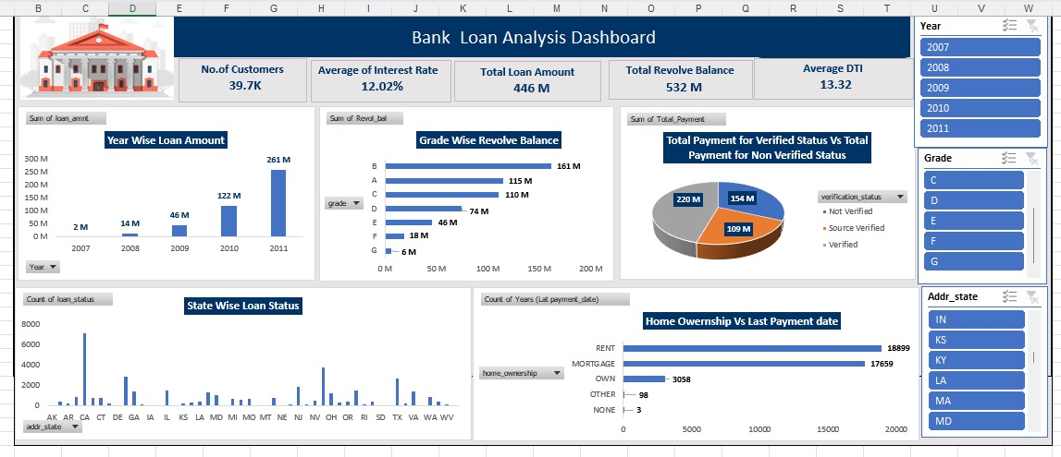
Excel DashBoard

Slide 10
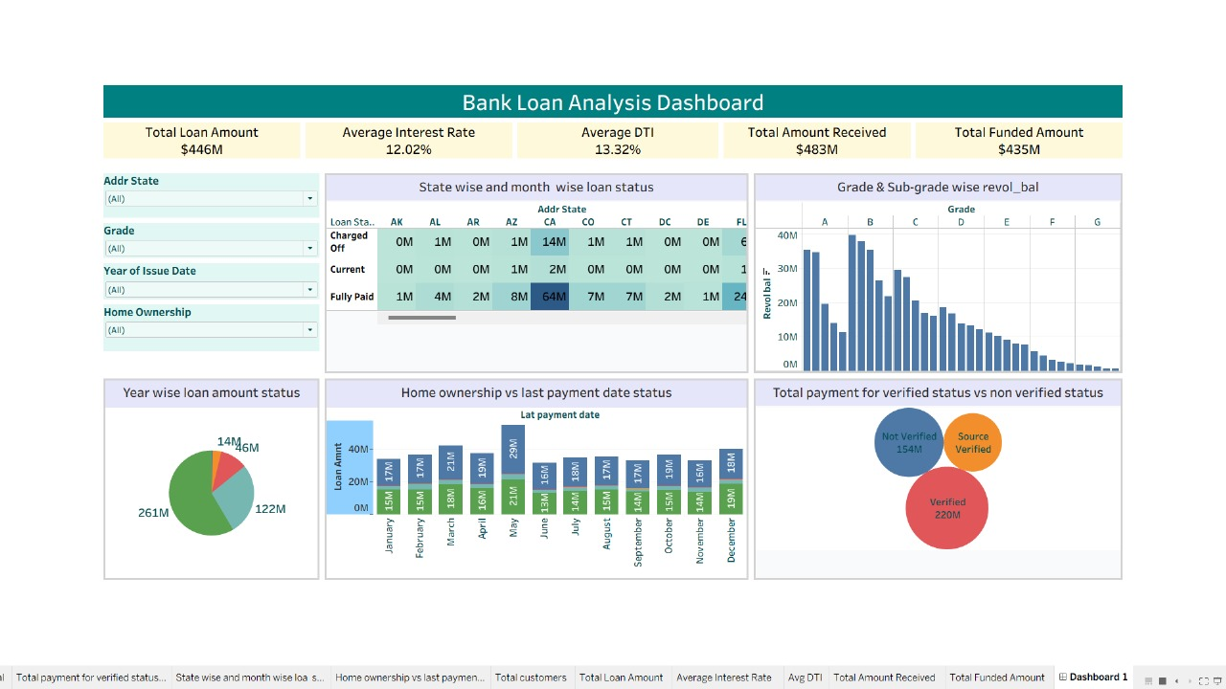
Tableau DashBoard

Slide 11
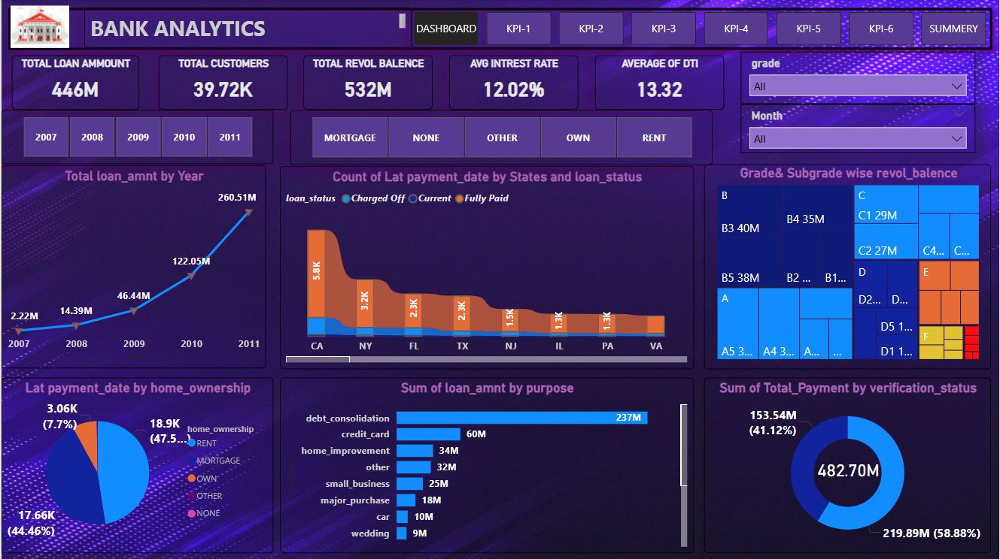
Power Bi DashBoard

Slide 12
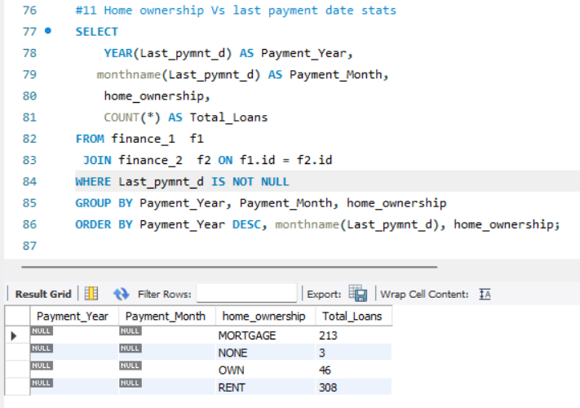
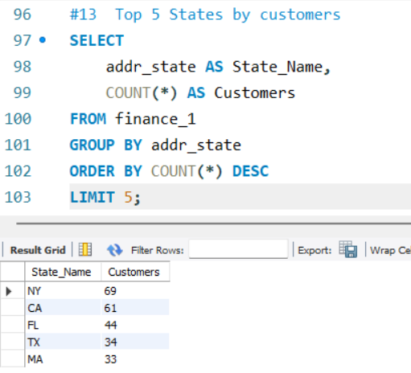
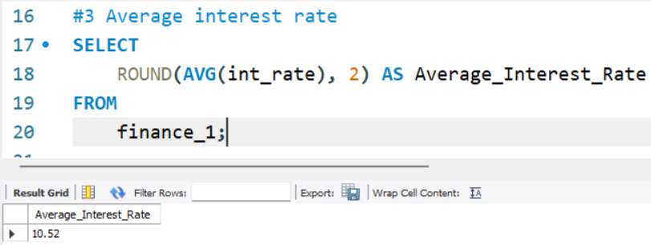
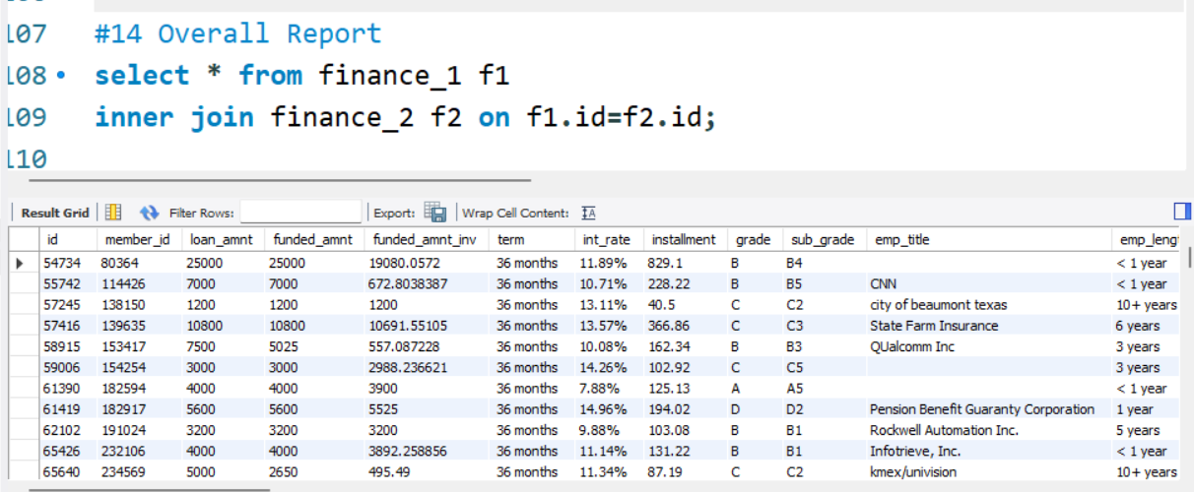
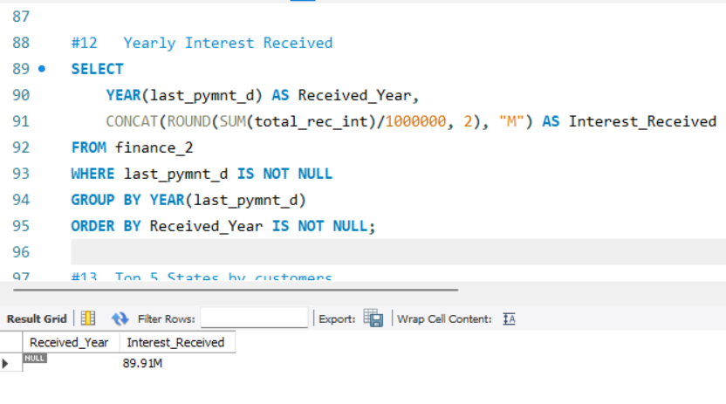
SQL Analysis

Slide 13

Thank You

